Slide 1
kubernetes

Slide 2
Overview
Kubernetes is a portable, extensible, open source platform for managing containerized workloads and services, that facilitates both declarative configuration and automation. It has a large, rapidly growing ecosystem. Kubernetes services, support, and tools are widely available.
The name Kubernetes originates from Greek, meaning helmsman or pilot. K8s as an abbreviation results from counting the eight letters between the "K" and the "s". Google open-sourced the Kubernetes project in 2014. Kubernetes combines over 15 years of Google's experience running production workloads at scale with best-of-breed ideas and practices from the community.

Slide 3
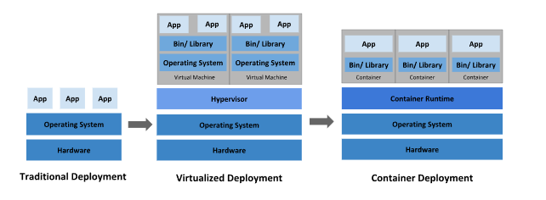
Going back in time
Let's take a look at why Kubernetes is so useful by going back in time.

Slide 4
Traditional deployment era
Early on, organizations ran applications on physical servers. There was no way to define resource boundaries for applications in a physical server, and this caused resource allocation issues. For example, if multiple applications run on a physical server, there can be instances where one application would take up most of the resources, and as a result, the other applications would underperform. A solution for this would be to run each application on a different physical server. But this did not scale as resources were underutilized, and it was expensive for organizations to maintain many physical servers.

Slide 5
Virtualized deployment era
As a solution, virtualization was introduced. It allows you to run multiple Virtual Machines (VMs) on a single physical server's CPU. Virtualization allows applications to be isolated between VMs and provides a level of security as the information of one application cannot be freely accessed by another application.
Virtualization allows better utilization of resources in a physical server and allows better scalability because an application can be added or updated easily, reduces hardware costs, and much more. With virtualization you can present a set of physical resources as a cluster of disposable virtual machines.
Each VM is a full machine running all the components, including its own operating system, on top of the virtualized hardware.

Slide 6
Container deployment era
Containers are similar to VMs, but they have relaxed isolation properties to share the Operating System (OS) among the applications. Therefore, containers are considered lightweight. Similar to a VM, a container has its own filesystem, share of CPU, memory, process space, and more. As they are decoupled from the underlying infrastructure, they are portable across clouds and OS distributions.
Containers have become popular because they provide extra benefits, such as:
Agile application creation and deployment: increased ease and efficiency of container image creation compared to VM image use.
Continuous development, integration, and deployment: provides for reliable and frequent container image build and deployment with quick and efficient rollbacks (due to image immutability).

Slide 7
Dev and Ops separation of concerns: create application container images at build/release time rather than deployment time, thereby decoupling applications from infrastructure.
Observability: not only surfaces OS-level information and metrics, but also application health and other signals.
Environmental consistency across development, testing, and production: runs the same on a laptop as it does in the cloud.
Cloud and OS distribution portability: runs on Ubuntu, RHEL, CoreOS, on-premises, on major public clouds, and anywhere else.
Application-centric management: raises the level of abstraction from running an OS on virtual hardware to running an application on an OS using logical resources.
Loosely coupled, distributed, elastic, liberated micro-services: applications are broken into smaller, independent pieces and can be deployed and managed dynamically – not a monolithic stack running on one big single-purpose machine.
Resource isolation: predictable application performance.
Resource utilization: high efficiency and density.

Slide 8
Why you need Kubernetes and what it can do
Containers are a good way to bundle and run your applications. In a production environment, you need to manage the containers that run the applications and ensure that there is no downtime. For example, if a container goes down, another container needs to start. Wouldn't it be easier if this behavior was handled by a system?
That's how Kubernetes comes to the rescue! Kubernetes provides you with a framework to run distributed systems resiliently. It takes care of scaling and failover for your application, provides deployment patterns, and more. For example: Kubernetes can easily manage a canary deployment for your system.

Slide 9
Kubernetes provides you with:
Service discovery and load balancing Kubernetes can expose a container using the DNS name or using their own IP address. If traffic to a container is high, Kubernetes is able to load balance and distribute the network traffic so that the deployment is stable.
Storage orchestration Kubernetes allows you to automatically mount a storage system of your choice, such as local storages, public cloud providers, and more.
Automated rollouts and rollbacks You can describe the desired state for your deployed containers using Kubernetes, and it can change the actual state to the desired state at a controlled rate. For example, you can automate Kubernetes to create new containers for your deployment, remove existing containers and adopt all their resources to the new container.
Automatic bin packing You provide Kubernetes with a cluster of nodes that it can use to run containerized tasks. You tell Kubernetes how much CPU and memory (RAM) each container needs. Kubernetes can fit containers onto your nodes to make the best use of your resources.
Self-healing Kubernetes restarts containers that fail, replaces containers, kills containers that don't respond to your user-defined health check, and doesn't advertise them to clients until they are ready to serve.
Secret and configuration management Kubernetes lets you store and manage sensitive information, such as passwords, OAuth tokens, and SSH keys. You can deploy and update secrets and application configuration without rebuilding your container images, and without exposing secrets in your stack configuration.
Batch execution In addition to services, Kubernetes can manage your batch and CI workloads, replacing containers that fail, if desired.
Horizontal scaling Scale your application up and down with a simple command, with a UI, or automatically based on CPU usage.
IPv4/IPv6 dual-stack Allocation of IPv4 and IPv6 addresses to Pods and Services
Designed for extensibility Add features to your Kubernetes cluster without changing upstream source code.

Slide 10
What Kubernetes is not
Kubernetes is not a traditional, all-inclusive PaaS (Platform as a Service) system. Since Kubernetes operates at the container level rather than at the hardware level, it provides some generally applicable features common to PaaS offerings, such as deployment, scaling, load balancing, and lets users integrate their logging, monitoring, and alerting solutions. However, Kubernetes is not monolithic, and these default solutions are optional and pluggable. Kubernetes provides the building blocks for building developer platforms, but preserves user choice and flexibility where it is important.

Slide 11
Kubernetes:
Does not limit the types of applications supported. Kubernetes aims to support an extremely diverse variety of workloads, including stateless, stateful, and data-processing workloads. If an application can run in a container, it should run great on Kubernetes.
Does not deploy source code and does not build your application. Continuous Integration, Delivery, and Deployment (CI/CD) workflows are determined by organization cultures and preferences as well as technical requirements.
Does not provide application-level services, such as middleware (for example, message buses), data-processing frameworks (for example, Spark), databases (for example, MySQL), caches, nor cluster storage systems (for example, Ceph) as built-in services. Such components can run on Kubernetes, and/or can be accessed by applications running on Kubernetes through portable mechanisms, such as the Open Service Broker.
Does not dictate logging, monitoring, or alerting solutions. It provides some integrations as proof of concept, and mechanisms to collect and export metrics.
Does not provide nor mandate a configuration language/system (for example, Jsonnet). It provides a declarative API that may be targeted by arbitrary forms of declarative specifications.
Does not provide nor adopt any comprehensive machine configuration, maintenance, management, or self-healing systems.
Additionally, Kubernetes is not a mere orchestration system. In fact, it eliminates the need for orchestration. The technical definition of orchestration is execution of a defined workflow: first do A, then B, then C. In contrast, Kubernetes comprises a set of independent, composable control processes that continuously drive the current state towards the provided desired state. It shouldn't matter how you get from A to C. Centralized control is also not required. This results in a system that is easier to use and more powerful, robust, resilient, and extensible.

Slide 12
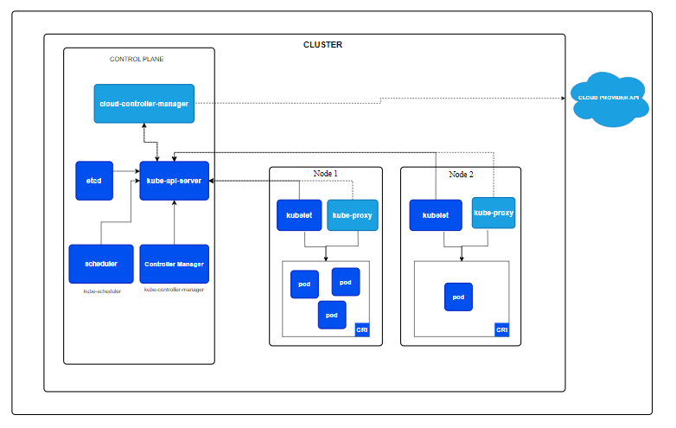
Cluster Architecture

Slide 13
Nodes
Kubernetes runs your workload by placing containers into Pods to run on Nodes. A node may be a virtual or physical machine, depending on the cluster. Each node is managed by the control plane and contains the services necessary to run Pods.
Typically you have several nodes in a cluster; in a learning or resource-limited environment, you might have only one node.
The components on a node include the kubelet, a container runtime, and the kube-proxy.
Notes:
https://kubernetes.io/docs/concepts/architecture/nodes/

Slide 14
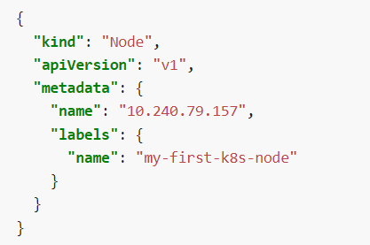
Management
There are two main ways to have Nodes added to the API server:
The kubelet on a node self-registers to the control plane
You (or another human user) manually add a Node object
After you create a Node object, or the kubelet on a node self-registers, the control plane checks whether the new Node object is valid. For example, if you try to create a Node from the following JSON manifest:

Slide 15
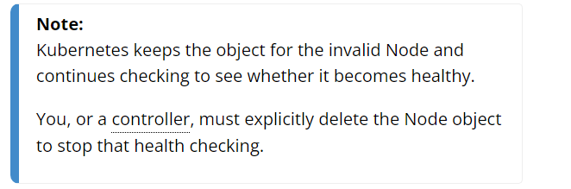
Kubernetes creates a Node object internally (the representation). Kubernetes checks that a kubelet has registered to the API server that matches the metadata.name field of the Node. If the node is healthy (i.e. all necessary services are running), then it is eligible to run a Pod. Otherwise, that node is ignored for any cluster activity until it becomes healthy.

Slide 16
Communication between Nodes and the Control Plane
Node to Control Plane
Kubernetes has a "hub-and-spoke" API pattern. All API usage from nodes (or the pods they run) terminates at the API server. None of the other control plane components are designed to expose remote services. The API server is configured to listen for remote connections on a secure HTTPS port (typically 443) with one or more forms of client authentication enabled. One or more forms of authorization should be enabled, especially if anonymous requests or service account tokens are allowed.
Control plane to node
There are two primary communication paths from the control plane (the API server) to the nodes. The first is from the API server to the kubelet process which runs on each node in the cluster. The second is from the API server to any node, pod, or service through the API server's proxy functionality.
Notes:
https://kubernetes.io/docs/concepts/architecture/control-plane-node-communication/

Slide 17
Namespaces
In Kubernetes, namespaces provides a mechanism for isolating groups of resources within a single cluster. Names of resources need to be unique within a namespace, but not across namespaces. Namespace-based scoping is applicable only for namespaced objects (e.g. Deployments, Services, etc) and not for cluster-wide objects (e.g. StorageClass, Nodes, PersistentVolumes, etc).
Notes:
https://kubernetes.io/docs/concepts/overview/working-with-objects/namespaces/

Slide 18
When to Use Multiple Namespaces
Namespaces are intended for use in environments with many users spread across multiple teams, or projects. For clusters with a few to tens of users, you should not need to create or think about namespaces at all. Start using namespaces when you need the features they provide.
Namespaces provide a scope for names. Names of resources need to be unique within a namespace, but not across namespaces. Namespaces cannot be nested inside one another and each Kubernetes resource can only be in one namespace.
Namespaces are a way to divide cluster resources between multiple users (via resource quota).
It is not necessary to use multiple namespaces to separate slightly different resources, such as different versions of the same software: use labels to distinguish resources within the same namespace.

Slide 19
Initial namespaces
Kubernetes starts with four initial namespaces:
default
Kubernetes includes this namespace so that you can start using your new cluster without first creating a namespace.
kube-node-lease
This namespace holds Lease objects associated with each node. Node leases allow the kubelet to send heartbeats so that the control plane can detect node failure.
kube-public
This namespace is readable by all clients (including those not authenticated). This namespace is mostly reserved for cluster usage, in case that some resources should be visible and readable publicly throughout the whole cluster. The public aspect of this namespace is only a convention, not a requirement.
kube-system
The namespace for objects created by the Kubernetes system

Slide 20
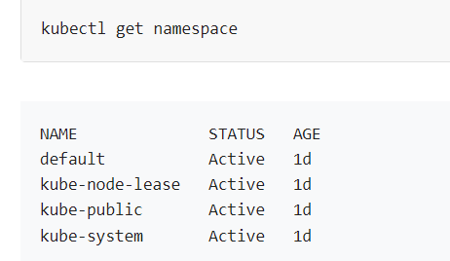
Working with Namespaces
Viewing namespaces
You can list the current namespaces in a cluster using:

Slide 21
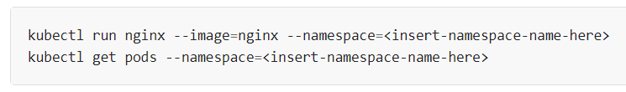
Setting the namespace for a request
To set the namespace for a current request, use the --namespace flag.
For example:

Slide 22
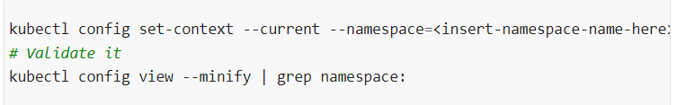
Setting the namespace preference
You can permanently save the namespace for all subsequent kubectl commands in that context.

Slide 23
Namespaces and DNS
When you create a Service, it creates a corresponding DNS entry. This entry is of the form <service-name>.<namespace-name>.svc.cluster.local, which means that if a container only uses <service-name>, it will resolve to the service which is local to a namespace. This is useful for using the same configuration across multiple namespaces such as Development, Staging and Production. If you want to reach across namespaces, you need to use the fully qualified domain name (FQDN).
As a result, all namespace names must be valid RFC 1123 DNS labels.

Slide 24
Deployments
A Deployment provides declarative updates for Pods and ReplicaSets.
You describe a desired state in a Deployment, and the Deployment Controller changes the actual state to the desired state at a controlled rate. You can define Deployments to create new ReplicaSets, or to remove existing Deployments and adopt all their resources with new Deployments.
Notes:
https://kubernetes.io/docs/concepts/workloads/controllers/deployment/

Slide 25
Use Case
The following are typical use cases for Deployments:
Create a Deployment to rollout a ReplicaSet. The ReplicaSet creates Pods in the background. Check the status of the rollout to see if it succeeds or not.
Declare the new state of the Pods by updating the PodTemplateSpec of the Deployment. A new ReplicaSet is created and the Deployment manages moving the Pods from the old ReplicaSet to the new one at a controlled rate. Each new ReplicaSet updates the revision of the Deployment.
Rollback to an earlier Deployment revision if the current state of the Deployment is not stable. Each rollback updates the revision of the Deployment.
Scale up the Deployment to facilitate more load.
Pause the rollout of a Deployment to apply multiple fixes to its PodTemplateSpec and then resume it to start a new rollout.
Use the status of the Deployment as an indicator that a rollout has stuck.
Clean up older ReplicaSets that you don't need anymore.

Slide 26
Creating a Deployment
The following is an example of a Deployment. It creates a ReplicaSet to bring up three nginx Pods:

Slide 27
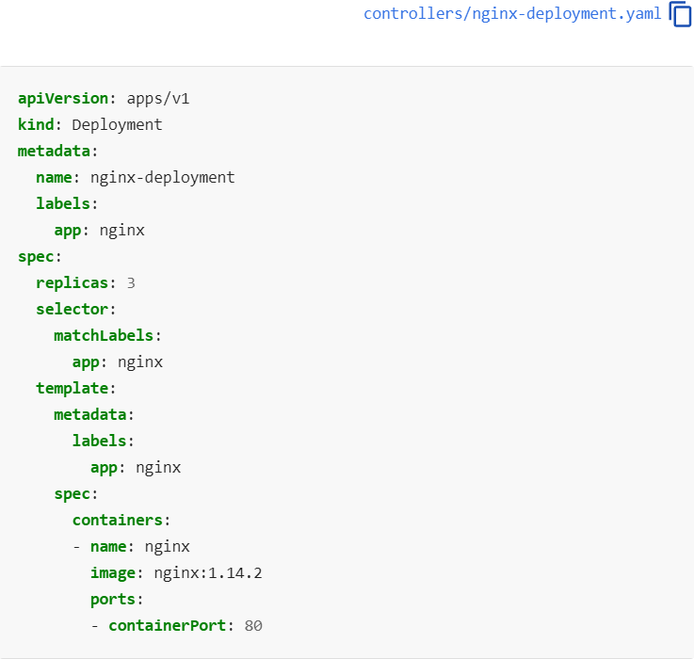

Slide 28
In this example:
A Deployment named nginx-deployment is created, indicated by the .metadata.name field. This name will become the basis for the ReplicaSets and Pods which are created later. See Writing a Deployment Spec for more details.
The Deployment creates a ReplicaSet that creates three replicated Pods, indicated by the .spec.replicas field.
The .spec.selector field defines how the created ReplicaSet finds which Pods to manage. In this case, you select a label that is defined in the Pod template (app: nginx). However, more sophisticated selection rules are possible, as long as the Pod template itself satisfies the rule.

Slide 29
The template field contains the following sub-fields:
The Pods are labeled app: nginxusing the .metadata.labels field.
The Pod template's specification, or .template.spec field, indicates that the Pods run one container, nginx, which runs the nginx Docker Hub image at version 1.14.2.
Create one container and name it nginx using the .spec.template.spec.containers[0].name field.

Slide 30

Before you begin, make sure your Kubernetes cluster is up and running. Follow the steps given below to create the above Deployment:
Create the Deployment by running the following command:
kubectl apply -f https://k8s.io/examples/controllers/nginx-deployment.yaml
Run kubectl get deployments to check if the Deployment was created.
If the Deployment is still being created, the output is similar to the following:

Slide 31
When you inspect the Deployments in your cluster, the following fields are displayed:
NAME lists the names of the Deployments in the namespace.
READY displays how many replicas of the application are available to your users. It follows the pattern ready/desired.
UP-TO-DATE displays the number of replicas that have been updated to achieve the desired state.
AVAILABLE displays how many replicas of the application are available to your users.
AGE displays the amount of time that the application has been running.

Slide 32


To see the Deployment rollout status, run
kubectl rollout status deployment/nginx-deployment
Run the kubectl get deployments again a few seconds later. The output is similar to this:

Slide 33
To see the ReplicaSet (rs) created by the Deployment, run kubectl get rs. The output is similar to this:
ReplicaSet output shows the following fields:
NAME lists the names of the ReplicaSets in the namespace.
DESIRED displays the desired number of replicas of the application, which you define when you create the Deployment. This is the desired state.
CURRENT displays how many replicas are currently running.
READY displays how many replicas of the application are available to your users.
AGE displays the amount of time that the application has been running.

Slide 34
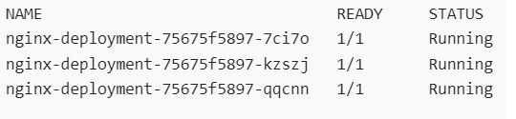
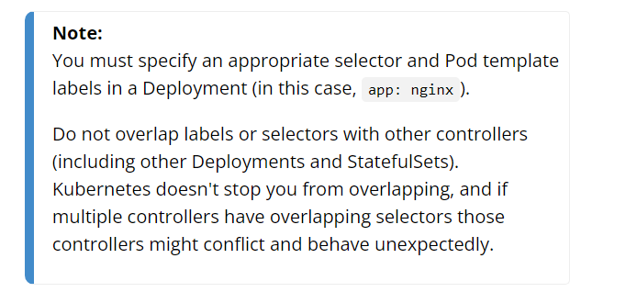
To see the labels automatically generated for each Pod, run kubectl get pods --show-labels. The output is similar to:

Slide 35
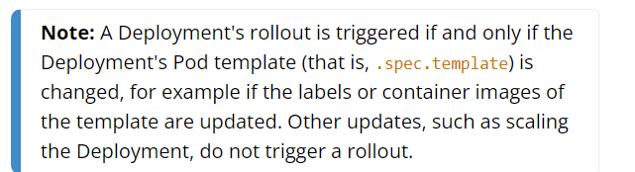
Updating a Deployment

Slide 36
Follow the steps given below to update your Deployment:
Let's update the nginx Pods to use the nginx:1.16.1 image instead of the nginx:1.14.2 image.
kubectl set image deployment.v1.apps/nginx-deployment nginx=nginx:1.16.1
or use the following command:
kubectl set image deployment/nginx-deployment nginx=nginx:1.16.1

Slide 37
where deployment/nginx-deployment indicates the Deployment, nginx indicates the Container the update will take place and nginx:1.16.1 indicates the new image and its tag.
The output is similar to:
deployment.apps/nginx-deployment image updated

Slide 38
Alternatively, you can edit the Deployment and change .spec.template.spec.containers[0].image from nginx:1.14.2 to nginx:1.16.1:
kubectl edit deployment/nginx-deployment
The output is similar to:
deployment.apps/nginx-deployment edited

Slide 39
To see the rollout status, run:
kubectl rollout status deployment/nginx-deployment
The output is similar to this:
Waiting for rollout to finish: 2 out of 3 new replicas have been updated...
or
deployment "nginx-deployment" successfully rolled out

Slide 40
kubectl get rs
kubectl get pods
kubectl describe deployments

Slide 41
Day 2
Notes:
https://www.airplane.dev/blog/kubernetes-projects-for-beginners

Slide 42
Understanding Kubernetes objects
Kubernetes objects are persistent entities in the Kubernetes system. Kubernetes uses these entities to represent the state of your cluster. Specifically, they can describe:
What containerized applications are running (and on which nodes)
The resources available to those applications
The policies around how those applications behave, such as restart policies, upgrades, and fault-tolerance
A Kubernetes object is a "record of intent"--once you create the object, the Kubernetes system will constantly work to ensure that object exists. By creating an object, you're effectively telling the Kubernetes system what you want your cluster's workload to look like; this is your cluster's desired state.
Notes:
https://kubernetes.io/docs/concepts/overview/working-with-objects/

Slide 43
Object spec and status
Almost every Kubernetes object includes two nested object fields that govern the object's configuration: the object spec and the object status. For objects that have a spec, you have to set this when you create the object, providing a description of the characteristics you want the resource to have: its desired state.
The status describes the current state of the object, supplied and updated by the Kubernetes system and its components. The Kubernetes control plane continually and actively manages every object's actual state to match the desired state you supplied.
For example: in Kubernetes, a Deployment is an object that can represent an application running on your cluster. When you create the Deployment, you might set the Deployment spec to specify that you want three replicas of the application to be running. The Kubernetes system reads the Deployment spec and starts three instances of your desired application--updating the status to match your spec. If any of those instances should fail (a status change), the Kubernetes system responds to the difference between spec and status by making a correction--in this case, starting a replacement instance.

Slide 44
Describing a Kubernetes object
hen you create an object in Kubernetes, you must provide the object spec that describes its desired state, as well as some basic information about the object (such as a name). When you use the Kubernetes API to create the object (either directly or via kubectl), that API request must include that information as JSON in the request body. Most often, you provide the information to kubectl in file known as a manifest. By convention, manifests are YAML (you could also use JSON format). Tools such as kubectl convert the information from a manifest into JSON or another supported serialization format when making the API request over HTTP.
Here's an example manifest that shows the required fields and object spec for a Kubernetes Deployment:

Slide 45
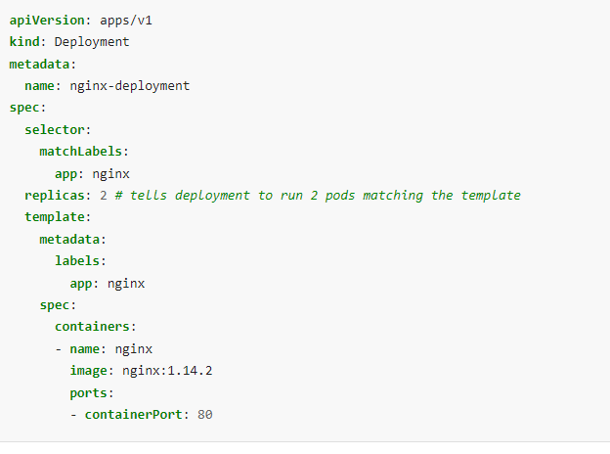
Example object
kubectl apply -f https://k8s.io/examples/application/deployment.yaml

Slide 46
Required fields
In the manifest (YAML or JSON file) for the Kubernetes object you want to create, you'll need to set values for the following fields:
apiVersion - Which version of the Kubernetes API you're using to create this object
kind - What kind of object you want to create
metadata - Data that helps uniquely identify the object, including a name string, UID, and optional namespace
spec - What state you desire for the object
The precise format of the object spec is different for every Kubernetes object, and contains nested fields specific to that object. The Kubernetes API Reference can help you find the spec format for all of the objects you can create using Kubernetes.

Slide 47
For example, see the spec field for the Pod API reference. For each Pod, the .spec field specifies the pod and its desired state (such as the container image name for each container within that pod). Another example of an object specification is the spec field for the StatefulSet API.
For StatefulSet, the .spec field specifies the StatefulSet and its desired state. Within the .spec of a StatefulSet is a template for Pod objects. That template describes Pods that the StatefulSet controller will create in order to satisfy the StatefulSet specification. Different kinds of object can also have different .status; again, the API reference pages detail the structure of that .status field, and its content for each different type of object.

Slide 48
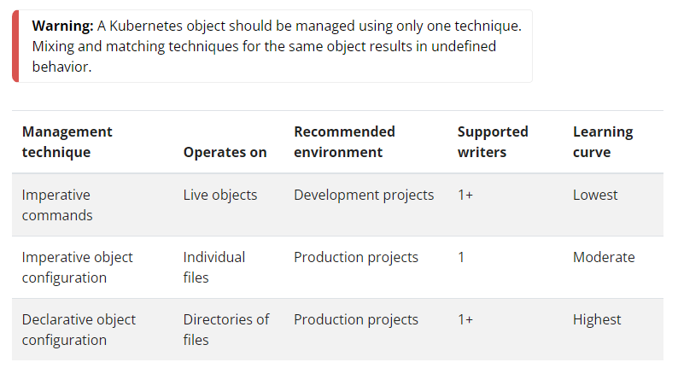
Management techniques

Slide 49
Imperative commands
When using imperative commands, a user operates directly on live objects in a cluster. The user provides operations to the kubectl command as arguments or flags.
This is the recommended way to get started or to run a one-off task in a cluster. Because this technique operates directly on live objects, it provides no history of previous configurations.
Examples
Run an instance of the nginx container by creating a Deployment object:
kubectl create deployment nginx --image nginx

Slide 50
Trade-offs
Advantages compared to object configuration:
Commands are expressed as a single action word.
Commands require only a single step to make changes to the cluster.
Disadvantages compared to object configuration:
Commands do not integrate with change review processes.
Commands do not provide an audit trail associated with changes.
Commands do not provide a source of records except for what is live.
Commands do not provide a template for creating new objects.

Slide 51
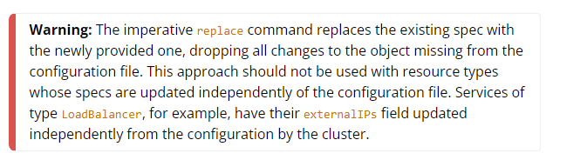
Imperative object configuration
In imperative object configuration, the kubectl command specifies the operation (create, replace, etc.), optional flags and at least one file name. The file specified must contain a full definition of the object in YAML or JSON format.

Slide 52
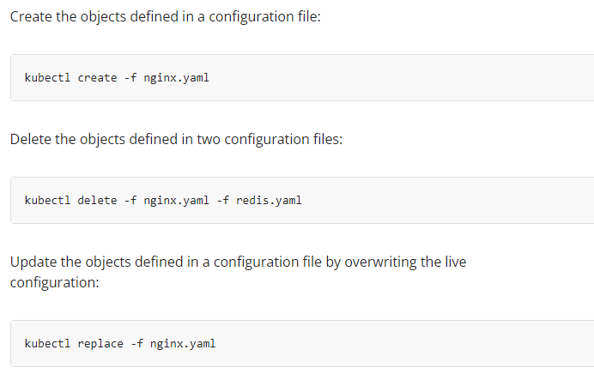
Examples

Slide 53
Trade-offs
Advantages compared to imperative commands:
Object configuration can be stored in a source control system such as Git.
Object configuration can integrate with processes such as reviewing changes before push and audit trails.
Object configuration provides a template for creating new objects.
Disadvantages compared to imperative commands:
Object configuration requires basic understanding of the object schema.
Object configuration requires the additional step of writing a YAML file.

Slide 54
Trade-offs
Advantages compared to declarative object configuration:
Imperative object configuration behavior is simpler and easier to understand.
As of Kubernetes version 1.5, imperative object configuration is more mature.
Disadvantages compared to declarative object configuration:
Imperative object configuration works best on files, not directories.
Updates to live objects must be reflected in configuration files, or they will be lost during the next replacement.

Slide 55
Declarative object configuration
When using declarative object configuration, a user operates on object configuration files stored locally, however the user does not define the operations to be taken on the files. Create, update, and delete operations are automatically detected per-object by kubectl. This enables working on directories, where different operations might be needed for different objects.

Slide 56
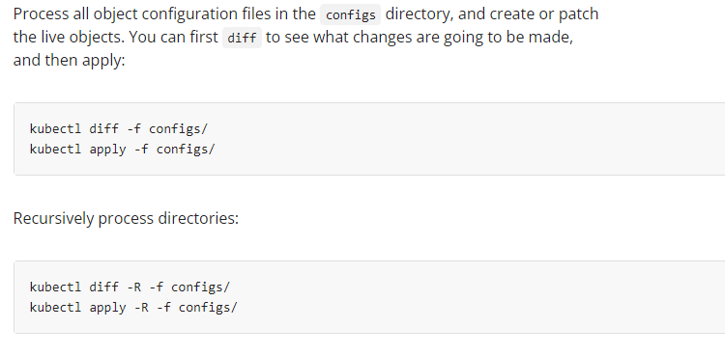
Examples

Slide 57
Trade-offs
Advantages compared to imperative object configuration:
Changes made directly to live objects are retained, even if they are not merged back into the configuration files.
Declarative object configuration has better support for operating on directories and automatically detecting operation types (create, patch, delete) per-object.
Disadvantages compared to imperative object configuration:
Declarative object configuration is harder to debug and understand results when they are unexpected.
Partial updates using diffs create complex merge and patch operations.

Slide 58
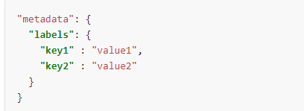
Labels and Selectors
Labels are key/value pairs that are attached to objects such as Pods. Labels are intended to be used to specify identifying attributes of objects that are meaningful and relevant to users, but do not directly imply semantics to the core system. Labels can be used to organize and to select subsets of objects. Labels can be attached to objects at creation time and subsequently added and modified at any time. Each object can have a set of key/value labels defined. Each Key must be unique for a given object.

Slide 59
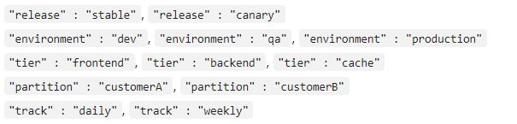
Motivation
Labels enable users to map their own organizational structures onto system objects in a loosely coupled fashion, without requiring clients to store these mappings.
Service deployments and batch processing pipelines are often multi-dimensional entities (e.g., multiple partitions or deployments, multiple release tracks, multiple tiers, multiple micro-services per tier). Management often requires cross-cutting operations, which breaks encapsulation of strictly hierarchical representations, especially rigid hierarchies determined by the infrastructure rather than by users.

Slide 60
Label selectors
Unlike names and UIDs, labels do not provide uniqueness. In general, we expect many objects to carry the same label(s).
Via a label selector, the client/user can identify a set of objects. The label selector is the core grouping primitive in Kubernetes.
The API currently supports two types of selectors: equality-based and set-based. A label selector can be made of multiple requirements which are comma-separated. In the case of multiple requirements, all must be satisfied so the comma separator acts as a logical AND (&&) operator.
The semantics of empty or non-specified selectors are dependent on the context, and API types that use selectors should document the validity and meaning of them.

Slide 61
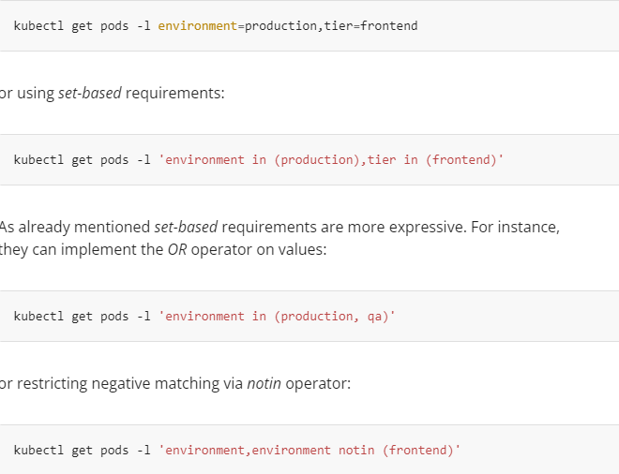

Slide 62

https://kubernetes.io/docs/concepts/overview/working-with-objects/object-management/
Going over kubernetes objects
Especially need to check field selecters labels etc

Slide 63
Cluster Networking
Networking is a central part of Kubernetes, but it can be challenging to understand exactly how it is expected to work. There are 4 distinct networking problems to address:
Highly-coupled container-to-container communications: this is solved by Pods and localhost communications.
Pod-to-Pod communications: this is the primary focus of this document.
Pod-to-Service communications: this is covered by Services.
External-to-Service communications: this is also covered by Services.

Slide 64
Kubernetes is all about sharing machines between applications. Typically, sharing machines requires ensuring that two applications do not try to use the same ports. Coordinating ports across multiple developers is very difficult to do at scale and exposes users to cluster-level issues outside of their control.
Dynamic port allocation brings a lot of complications to the system - every application has to take ports as flags, the API servers have to know how to insert dynamic port numbers into configuration blocks, services have to know how to find each other, etc. Rather than deal with this, Kubernetes takes a different approach.

Slide 65
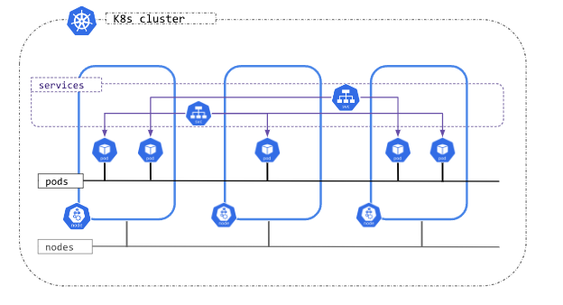
Kubernetes IP address ranges
Kubernetes clusters require to allocate non-overlapping IP addresses for Pods, Services and Nodes, from a range of available addresses configured in the following components:
The network plugin is configured to assign IP addresses to Pods.
The kube-apiserver is configured to assign IP addresses to Services.
The kubelet or the cloud-controller-manager is configured to assign IP addresses to Nodes.

Slide 66
Cluster networking types
Kubernetes clusters, attending to the IP families configured, can be categorized into:
IPv4 only: The network plugin, kube-apiserver and kubelet/cloud-controller-manager are configured to assign only IPv4 addresses.
IPv6 only: The network plugin, kube-apiserver and kubelet/cloud-controller-manager are configured to assign only IPv6 addresses.
IPv4/IPv6 or IPv6/IPv4 dual-stack:
The network plugin is configured to assign IPv4 and IPv6 addresses.
The kube-apiserver is configured to assign IPv4 and IPv6 addresses.
The kubelet or cloud-controller-manager is configured to assign IPv4 and IPv6 address.
All components must agree on the configured primary IP family.
Kubernetes clusters only consider the IP families present on the Pods, Services and Nodes objects, independently of the existing IPs of the represented objects. Per example, a server or a pod can have multiple IP addresses on its interfaces, but only the IP addresses in node.status.addresses or pod.status.ips are considered for implementing the Kubernetes network model and defining the type of the cluster

Slide 67
How to implement the Kubernetes network model
The network model is implemented by the container runtime on each node. The most common container runtimes use Container Network Interface (CNI) plugins to manage their network and security capabilities. Many different CNI plugins exist from many different vendors. Some of these provide only basic features of adding and removing network interfaces, while others provide more sophisticated solutions, such as integration with other container orchestration systems, running multiple CNI plugins, advanced IPAM features etc.

Slide 68
Services, Load Balancing, and Networking
Every Pod in a cluster gets its own unique cluster-wide IP address. This means you do not need to explicitly create links between Pods and you almost never need to deal with mapping container ports to host ports.
This creates a clean, backwards-compatible model where Pods can be treated much like VMs or physical hosts from the perspectives of port allocation, naming, service discovery, load balancing, application configuration, and migration.
Kubernetes imposes the following fundamental requirements on any networking implementation (barring any intentional network segmentation policies):
pods can communicate with all other pods on any other node without NAT
agents on a node (e.g. system daemons, kubelet) can communicate with all pods on that node

Slide 69
networking
Note: For those platforms that support Pods running in the host network (e.g. Linux), when pods are attached to the host network of a node they can still communicate with all pods on all nodes without NAT.
This model is not only less complex overall, but it is principally compatible with the desire for Kubernetes to enable low-friction porting of apps from VMs to containers. If your job previously ran in a VM, your VM had an IP and could talk to other VMs in your project. This is the same basic model.

Slide 70
networking
Kubernetes IP addresses exist at the Pod scope - containers within a Pod share their network namespaces - including their IP address and MAC address. This means that containers within a Pod can all reach each other's ports on localhost. This also means that containers within a Pod must coordinate port usage, but this is no different from processes in a VM. This is called the "IP-per-pod" model.
How this is implemented is a detail of the particular container runtime in use.
t is possible to request ports on the Node itself which forward to your Pod (called host ports), but this is a very niche operation. How that forwarding is implemented is also a detail of the container runtime. The Pod itself is blind to the existence or non-existence of host ports.

Slide 71
Networking
Kubernetes networking addresses four concerns:
Containers within a Pod use networking to communicate via loopback.
Cluster networking provides communication between different Pods.
The Service API lets you expose an application running in Pods to be reachable from outside your cluster.
Ingress provides extra functionality specifically for exposing HTTP applications, websites and APIs.
Gateway API is an add-on that provides an expressive, extensible, and role-oriented family of API kinds for modeling service networking.
You can also use Services to publish services only for consumption inside your cluster.

Slide 72
Service
n Kubernetes, a Service is a method for exposing a network application that is running as one or more Pods in your cluster.
A key aim of Services in Kubernetes is that you don't need to modify your existing application to use an unfamiliar service discovery mechanism. You can run code in Pods, whether this is a code designed for a cloud-native world, or an older app you've containerized. You use a Service to make that set of Pods available on the network so that clients can interact with it.
If you use a Deployment to run your app, that Deployment can create and destroy Pods dynamically. From one moment to the next, you don't know how many of those Pods are working and healthy; you might not even know what those healthy Pods are named. Kubernetes Pods are created and destroyed to match the desired state of your cluster. Pods are ephemeral resources (you should not expect that an individual Pod is reliable and durable).
Notes:
https://kubernetes.io/docs/concepts/services-networking/service/

Slide 73
Each Pod gets its own IP address (Kubernetes expects network plugins to ensure this). For a given Deployment in your cluster, the set of Pods running in one moment in time could be different from the set of Pods running that application a moment later.
This leads to a problem: if some set of Pods (call them "backends") provides functionality to other Pods (call them "frontends") inside your cluster, how do the frontends find out and keep track of which IP address to connect to, so that the frontend can use the backend part of the workload?

Slide 74
Services in Kubernetes
The Service API, part of Kubernetes, is an abstraction to help you expose groups of Pods over a network. Each Service object defines a logical set of endpoints (usually these endpoints are Pods) along with a policy about how to make those pods accessible.
For example, consider a stateless image-processing backend which is running with 3 replicas. Those replicas are fungible—frontends do not care which backend they use. While the actual Pods that compose the backend set may change, the frontend clients should not need to be aware of that, nor should they need to keep track of the set of backends themselves.
The Service abstraction enables this decoupling.

Slide 75
If your workload speaks HTTP, you might choose to use an Ingress to control how web traffic reaches that workload. Ingress is not a Service type, but it acts as the entry point for your cluster. An Ingress lets you consolidate your routing rules into a single resource, so that you can expose multiple components of your workload, running separately in your cluster, behind a single listener.
The Gateway API for Kubernetes provides extra capabilities beyond Ingress and Service. You can add Gateway to your cluster - it is a family of extension APIs, implemented using CustomResourceDefinitions - and then use these to configure access to network services that are running in your cluster.

Slide 76
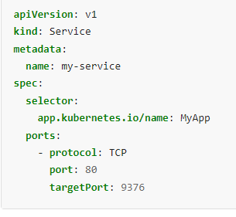
Defining a Service
A Service is an object (the same way that a Pod or a ConfigMap is an object). You can create, view or modify Service definitions using the Kubernetes API. Usually you use a tool such as kubectl to make those API calls for you.
For example, suppose you have a set of Pods that each listen on TCP port 9376 and are labelled as app.kubernetes.io/name=MyApp. You can define a Service to publish that TCP listener:

Slide 77
Applying this manifest creates a new Service named "my-service" with the default ClusterIP service type. The Service targets TCP port 9376 on any Pod with the app.kubernetes.io/name: MyApp label.
Kubernetes assigns this Service an IP address (the cluster IP), that is used by the virtual IP address mechanism. For more details on that mechanism, read Virtual IPs and Service Proxies.
The controller for that Service continuously scans for Pods that match its selector, and then makes any necessary updates to the set of EndpointSlices for the Service.
The name of a Service object must be a valid RFC 1035 label name.
Notes:
https://kubernetes.io/docs/reference/networking/virtual-ips/

Slide 78
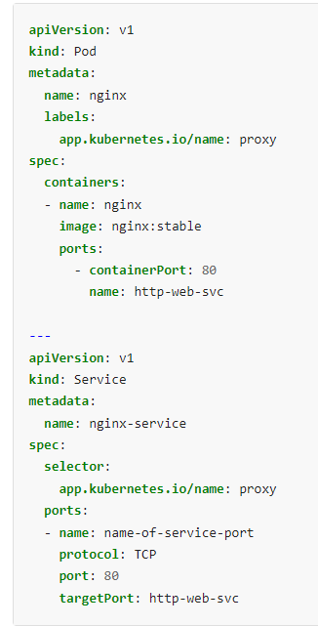
Port definitions
Port definitions in Pods have names, and you can reference these names in the targetPort attribute of a Service. For example, we can bind the targetPort of the Service to the Pod port in the following way:
This works even if there is a mixture of Pods in the Service using a single configured name, with the same network protocol available via different port numbers. This offers a lot of flexibility for deploying and evolving your Services. For example, you can change the port numbers that Pods expose in the next version of your backend software, without breaking clients.

Slide 79
Service type
For some parts of your application (for example, frontends) you may want to expose a Service onto an external IP address, one that's accessible from outside of your cluster.
Kubernetes Service types allow you to specify what kind of Service you want.
The available type values and their behaviors are:
ClusterIP
Exposes the Service on a cluster-internal IP. Choosing this value makes the Service only reachable from within the cluster. This is the default that is used if you don't explicitly specify a type for a Service. You can expose the Service to the public internet using an Ingress or a Gateway.

Slide 80
NodePort
Exposes the Service on each Node's IP at a static port (the NodePort). To make the node port available, Kubernetes sets up a cluster IP address, the same as if you had requested a Service of type: ClusterIP.
LoadBalancer
Exposes the Service externally using an external load balancer. Kubernetes does not directly offer a load balancing component; you must provide one, or you can integrate your Kubernetes cluster with a cloud provider.
ExternalName
Maps the Service to the contents of the externalName field (for example, to the hostname api.foo.bar.example). The mapping configures your cluster's DNS server to return a CNAME record with that external hostname value. No proxying of any kind is set up.
Notes:
https://kubernetes.io/docs/concepts/services-networking/service/#publishing-services-service-types
https://www.tigera.io/learn/guides/kubernetes-networking/

Slide 82
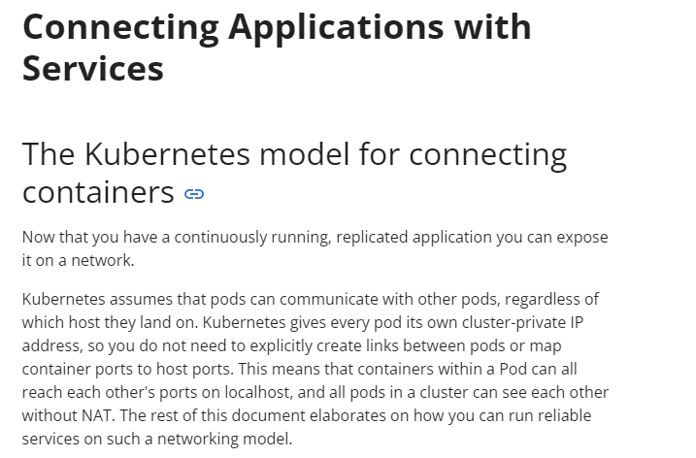
Tutorial: Services
Notes:
https://kubernetes.io/docs/tutorials/services/connect-applications-service/

Slide 83
https://kubernetes.io/docs/concepts/services-networking/service/
Todo: ingress, gateway api etc

Slide 86
configuration
Configuration Best Practices
ConfigMaps
Secrets
Resource Management for Pods and Containers
Organizing Cluster Access Using kubeconfig Files
Resource Management for Windows nodes
Notes:
https://kubernetes.io/docs/concepts/configuration/

Slide 87
Configuration Best Practices
When defining configurations, specify the latest stable API version.
Configuration files should be stored in version control before being pushed to the cluster. This allows you to quickly roll back a configuration change if necessary. It also aids cluster re-creation and restoration.
Write your configuration files using YAML rather than JSON. Though these formats can be used interchangeably in almost all scenarios, YAML tends to be more user-friendly.
Group related objects into a single file whenever it makes sense. One file is often easier to manage than several.
Note also that many kubectl commands can be called on a directory. For example, you can call kubectl apply on a directory of config files.
Don't specify default values unnecessarily: simple, minimal configuration will make errors less likely.
Put object descriptions in annotations, to allow better introspection.
Notes:
Extra for point 4
https://github.com/kubernetes/examples/tree/master/guestbook/all-in-one/guestbook-all-in-one.yaml

Slide 88
"Naked" Pods versus ReplicaSets, Deployments, and Jobs
Don't use naked Pods (that is, Pods not bound to a ReplicaSet or Deployment) if you can avoid it. Naked Pods will not be rescheduled in the event of a node failure.
A Deployment, which both creates a ReplicaSet to ensure that the desired number of Pods is always available, and specifies a strategy to replace Pods (such as RollingUpdate), is almost always preferable to creating Pods directly, except for some explicit restartPolicy: Never scenarios. A Job may also be appropriate.

Slide 89
Services
Create a Service before its corresponding backend workloads (Deployments or ReplicaSets), and before any workloads that need to access it. When Kubernetes starts a container, it provides environment variables pointing to all the Services which were running when the container was started. For example, if a Service named foo exists, all containers will get the following variables in their initial environment:
FOO_SERVICE_HOST=<the host the Service is running on>
FOO_SERVICE_PORT=<the port the Service is running on>
This does imply an ordering requirement - any Service that a Pod wants to access must be created before the Pod itself, or else the environment variables will not be populated. DNS does not have this restriction.

Slide 90
An optional (though strongly recommended) cluster add-on is a DNS server. The DNS server watches the Kubernetes API for new Services and creates a set of DNS records for each. If DNS has been enabled throughout the cluster then all Pods should be able to do name resolution of Services automatically.
Don't specify a hostPort for a Pod unless it is absolutely necessary. When you bind a Pod to a hostPort, it limits the number of places the Pod can be scheduled, because each <hostIP, hostPort, protocol> combination must be unique. If you don't specify the hostIP and protocol explicitly, Kubernetes will use 0.0.0.0 as the default hostIP and TCP as the default protocol.
If you only need access to the port for debugging purposes, you can use the apiserver proxy or kubectl port-forward.
If you explicitly need to expose a Pod's port on the node, consider using a NodePort Service before resorting to hostPort.
Avoid using hostNetwork, for the same reasons as hostPort.
Use headless Services (which have a ClusterIP of None) for service discovery when you don't need kube-proxy load balancing

Slide 91
Using labels
Define and use labels that identify semantic attributes of your application or Deployment, such as { app.kubernetes.io/name: MyApp, tier: frontend, phase: test, deployment: v3 }. You can use these labels to select the appropriate Pods for other resources; for example, a Service that selects all tier: frontend Pods, or all phase: test components of app.kubernetes.io/name: MyApp. See the guestbook app for examples of this approach.
A Service can be made to span multiple Deployments by omitting release-specific labels from its selector. When you need to update a running service without downtime, use a Deployment.
A desired state of an object is described by a Deployment, and if changes to that spec are applied, the deployment controller changes the actual state to the desired state at a controlled rate.
Notes:
https://github.com/kubernetes/examples/blob/master/guestbook/all-in-one/guestbook-all-in-one.yaml
https://github.com/kubernetes/examples/tree/master/guestbook/

Slide 92
Recommended Labels
You can visualize and manage Kubernetes objects with more tools than kubectl and the dashboard. A common set of labels allows tools to work interoperably, describing objects in a common manner that all tools can understand.
In addition to supporting tooling, the recommended labels describe applications in a way that can be queried.
The metadata is organized around the concept of an application. Kubernetes is not a platform as a service (PaaS) and doesn't have or enforce a formal notion of an application. Instead, applications are informal and described with metadata. The definition of what an application contains is loose.
Shared labels and annotations share a common prefix: app.kubernetes.io. Labels without a prefix are private to users. The shared prefix ensures that shared labels do not interfere with custom user labels

Slide 93
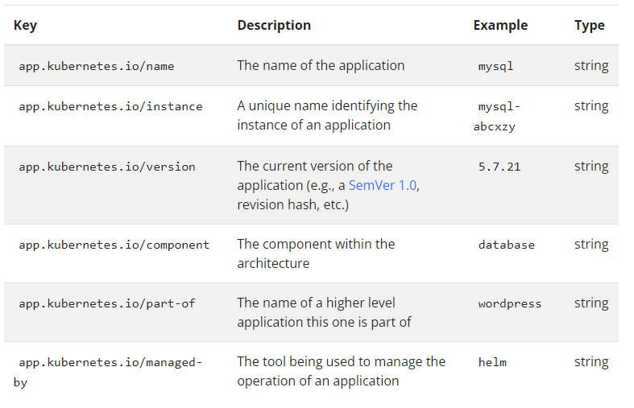

Slide 94
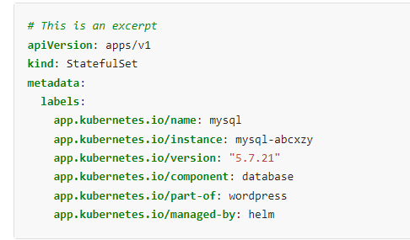
To illustrate these labels in action, consider the following StatefulSet object:

Slide 95
You can manipulate labels for debugging. Because Kubernetes controllers (such as ReplicaSet) and Services match to Pods using selector labels, removing the relevant labels from a Pod will stop it from being considered by a controller or from being served traffic by a Service. If you remove the labels of an existing Pod, its controller will create a new Pod to take its place. This is a useful way to debug a previously "live" Pod in a "quarantine" environment. To interactively remove or add labels, use
kubectl label

Slide 96
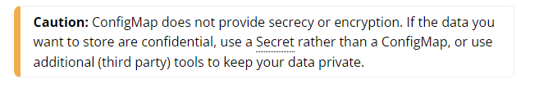
ConfigMaps
A ConfigMap is an API object used to store non-confidential data in key-value pairs. Pods can consume ConfigMaps as environment variables, command-line arguments, or as configuration files in a volume.
A ConfigMap allows you to decouple environment-specific configuration from your container images, so that your applications are easily portable.

Slide 97
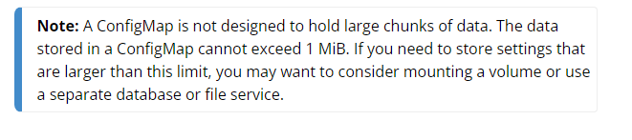
Motivation
Use a ConfigMap for setting configuration data separately from application code.
For example, imagine that you are developing an application that you can run on your own computer (for development) and in the cloud (to handle real traffic). You write the code to look in an environment variable named DATABASE_HOST. Locally, you set that variable to localhost. In the cloud, you set it to refer to a Kubernetes Service that exposes the database component to your cluster. This lets you fetch a container image running in the cloud and debug the exact same code locally if needed.

Slide 98
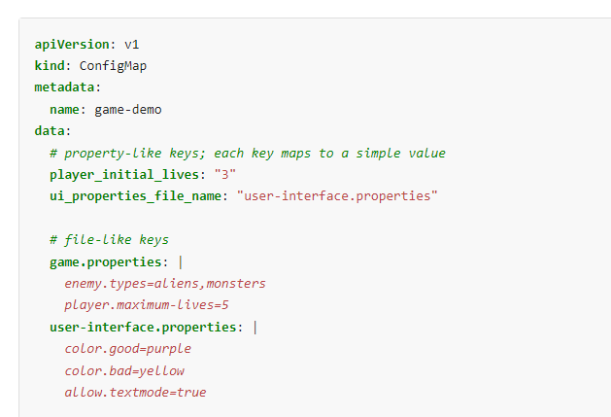

Slide 99
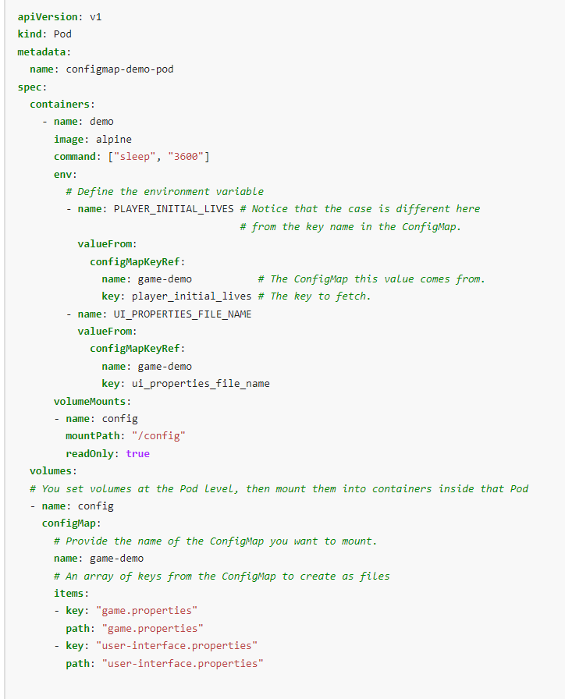

Slide 100
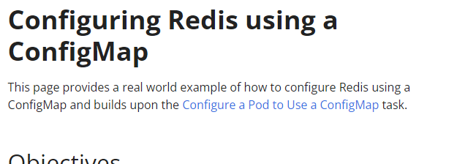
Exercise: Configure redis
https://kubernetes.io/docs/tutorials/configuration/configure-redis-using-configmap/

Slide 101
Secrets
A Secret is an object that contains a small amount of sensitive data such as a password, a token, or a key. Such information might otherwise be put in a Pod specification or in a container image. Using a Secret means that you don't need to include confidential data in your application code.
Because Secrets can be created independently of the Pods that use them, there is less risk of the Secret (and its data) being exposed during the workflow of creating, viewing, and editing Pods. Kubernetes, and applications that run in your cluster, can also take additional precautions with Secrets, such as avoiding writing sensitive data to nonvolatile storage.
Secrets are similar to ConfigMaps but are specifically intended to hold confidential data.

Slide 102
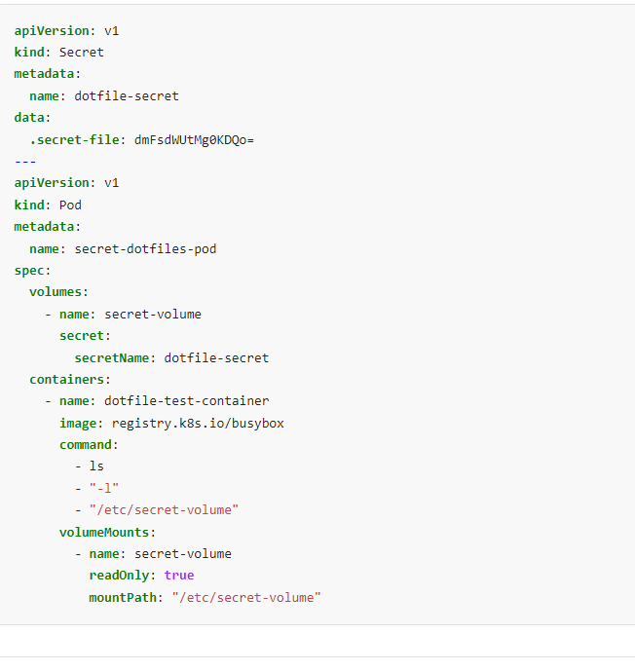
Notes:
https://kubernetes.io/docs/concepts/configuration/secret/

Slide 103
Resource Management for Pods and Containers
When you specify a Pod, you can optionally specify how much of each resource a container needs. The most common resources to specify are CPU and memory (RAM); there are others.
When you specify the resource request for containers in a Pod, the kube-scheduler uses this information to decide which node to place the Pod on. When you specify a resource limit for a container, the kubelet enforces those limits so that the running container is not allowed to use more of that resource than the limit you set. The kubelet also reserves at least the request amount of that system resource specifically for that container to use

Slide 104
Requests and limits
If the node where a Pod is running has enough of a resource available, it's possible (and allowed) for a container to use more resource than its request for that resource specifies. However, a container is not allowed to use more than its resource limit.
For example, if you set a memory request of 256 MiB for a container, and that container is in a Pod scheduled to a Node with 8GiB of memory and no other Pods, then the container can try to use more RAM.

Slide 105
If you set a memory limit of 4GiB for that container, the kubelet (and container runtime) enforce the limit. The runtime prevents the container from using more than the configured resource limit. For example: when a process in the container tries to consume more than the allowed amount of memory, the system kernel terminates the process that attempted the allocation, with an out of memory (OOM) error.
Limits can be implemented either reactively (the system intervenes once it sees a violation) or by enforcement (the system prevents the container from ever exceeding the limit). Different runtimes can have different ways to implement the same restrictions.

Slide 106
Resource types
CPU and memory are each a resource type. A resource type has a base unit. CPU represents compute processing and is specified in units of Kubernetes CPUs. Memory is specified in units of bytes. For Linux workloads, you can specify huge page resources. Huge pages are a Linux-specific feature where the node kernel allocates blocks of memory that are much larger than the default page size.
For example, on a system where the default page size is 4KiB, you could specify a limit, hugepages-2Mi: 80Mi. If the container tries allocating over 40 2MiB huge pages (a total of 80 MiB), that allocation fails.

Slide 107
Resource requests and limits of Pod and container
For each container, you can specify resource limits and requests, including the following:
spec.containers[].resources.limits.cpu
spec.containers[].resources.limits.memory
spec.containers[].resources.limits.hugepages-<size>
spec.containers[].resources.requests.cpu
spec.containers[].resources.requests.memory
spec.containers[].resources.requests.hugepages-<size>
Although you can only specify requests and limits for individual containers, it is also useful to think about the overall resource requests and limits for a Pod. For a particular resource, a Pod resource request/limit is the sum of the resource requests/limits of that type for each container in the Pod

Slide 108
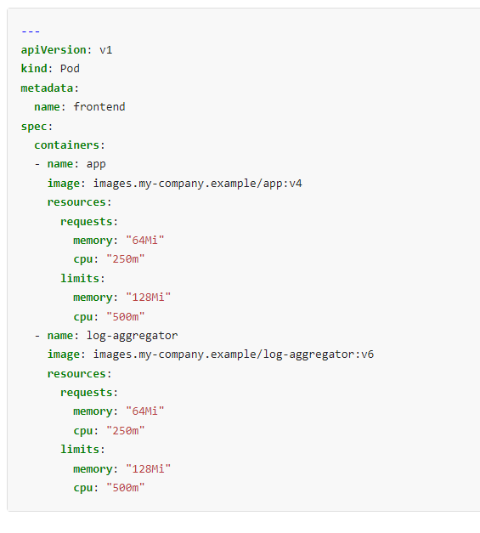
Container resources example
The following Pod has two containers. Both containers are defined with a request for 0.25 CPU and 64MiB (226 bytes) of memory. Each container has a limit of 0.5 CPU and 128MiB of memory. You can say the Pod has a request of 0.5 CPU and 128 MiB of memory, and a limit of 1 CPU and 256MiB of memory.

Slide 109
How Pods with resource requests are scheduled
When you create a Pod, the Kubernetes scheduler selects a node for the Pod to run on. Each node has a maximum capacity for each of the resource types: the amount of CPU and memory it can provide for Pods. The scheduler ensures that, for each resource type, the sum of the resource requests of the scheduled containers is less than the capacity of the node. Note that although actual memory or CPU resource usage on nodes is very low, the scheduler still refuses to place a Pod on a node if the capacity check fails. This protects against a resource shortage on a node when resource usage later increases, for example, during a daily peak in request rate

Slide 110
How Kubernetes applies resource requests and limits
When the kubelet starts a container as part of a Pod, the kubelet passes that container's requests and limits for memory and CPU to the container runtime.
On Linux, the container runtime typically configures kernel cgroups that apply and enforce the limits you defined.
The CPU limit defines a hard ceiling on how much CPU time that the container can use. During each scheduling interval (time slice), the Linux kernel checks to see if this limit is exceeded; if so, the kernel waits before allowing that cgroup to resume execution.
The CPU request typically defines a weighting. If several different containers (cgroups) want to run on a contended system, workloads with larger CPU requests are allocated more CPU time than workloads with small requests.
The memory request is mainly used during (Kubernetes) Pod scheduling. On a node that uses cgroups v2, the container runtime might use the memory request as a hint to set memory.min and memory.low.
The memory limit defines a memory limit for that cgroup. If the container tries to allocate more memory than this limit, the Linux kernel out-of-memory subsystem activates and, typically, intervenes by stopping one of the processes in the container that tried to allocate memory. If that process is the container's PID 1, and the container is marked as restartable, Kubernetes restarts the container.
The memory limit for the Pod or container can also apply to pages in memory backed volumes, such as an emptyDir. The kubelet tracks tmpfs emptyDir volumes as container memory use, rather than as local ephemeral storage.

Slide 111
https://kubernetes.io/docs/concepts/configuration/overview/
Best practices done, other config to go

Slide 112
Troubleshooting Clusters

Slide 113
https://kubernetes.io/docs/tasks/debug/debug-cluster/
https://kubernetes.io/docs/tasks/debug/
Troubleshooting

Slide 115
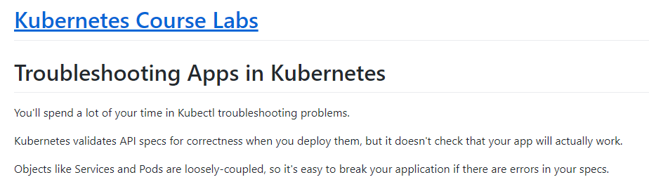
Exercise troubleshooting
https://kubernetes.courselabs.co/labs/troubleshooting/

Slide 116
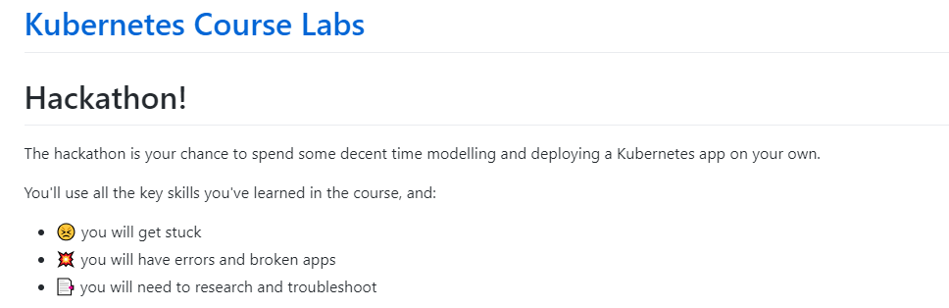
Exercise complete
https://kubernetes.courselabs.co/hackathon/

Slide 117
Storage
https://kubernetes.io/docs/concepts/storage/

Slide 118
storage
Longhorn
Redis
Etc

Slide 119
K3s Kubernetes cluster storage with Longhorn
https://medium.com/@pongsatt/k3s-kubernetes-cluster-storage-with-longhorn-ff201947d3f5
Notes:
https://kubebyexample.com/
https://kubernetes.courselabs.co/

